Slide 1
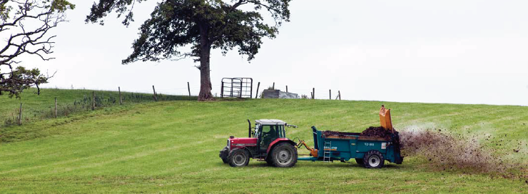
Cost-effective ‘basic’ on-farm measures to reduce water pollution
SCIENCE, POLICY AND PRACTICE NOTE I
Emma Pilgrim & Michael Winter (University of Exeter)
Adie Collins & Yusheng Zhang (Rothamsted Research)
Richard Gooday & Dave Skirvin (RSK ADAS)

Slide 2
The issue
Freshwater systems need to support our growing population by providing clean water for drinking and food production but are being degraded by pollutants faster than they can be restored locally, nationally, and globally
Water pollution is derived from many sources including agriculture

Slide 3
However…
In 2013, 33% of the UK’s surface/groundwater bodies failed to achieve ‘good’ status due to rural/agricultural land management practices
Pollutants being washed off farmland into rivers/streams include slurry, pesticides, fertilisers, and sediment
Excess diffuse water pollutants affects aquatic life by causing siltation and/or algal blooms
Farming is a major contributor of water pollutants in England and Wales = 25% of phosphate, over 50% of nitrate, and 75% of sediment in our rivers

Slide 4
Tackling the problem
Tackling water pollution at its source (on farms) is challenging and potentially costly due to variation in pollution risk both spatially (e.g. manure/slurry stores, soil types, steepness of slope) and temporally (e.g. during wetter months)
More efficient, targeted pollution control measures are needed to enable farmers to deliver demonstrable environmental outcomes
If cost effective for farmers, these measures are more likely to be implemented at higher uptake rates

Slide 5
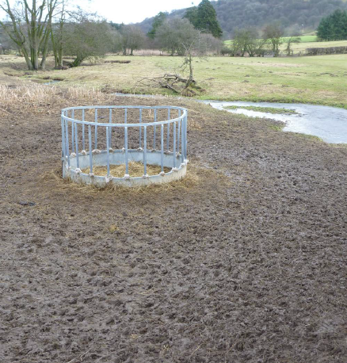
Why is soil important?
25% of the world’s biodiversity is found in soil, making it an essential natural resource
Poor soil management causes compaction, run-off and erosion, which leads to the depletion of organic matter, nutrients and biodiversity, and the degradation of water quality

Slide 6
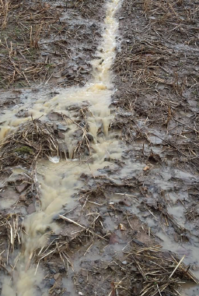
Know your soil type
Different soil types have distinctive hydrological properties which characterise the speed and direction of their dominant water pathways
Soil moisture affects bearing strength; wet soils are often not suited for arable cropping or intensive grassland but could instead create habitats for reducing run-off and water pollution

Slide 7
Soil types
Vegetation can also indicate soil type
e.g. rushes in areas which have been waterlogged long term
Wet soil can compress easily, becoming dense, structureless, and permeable
Dry soil has enough internal strength to support most farming operations
If soil doesn’t have sufficient bearing strength, radical changes in porosity can result after just one machinery pass; this leads to compaction

Slide 8
Damaged soil structure = increased runoff
There is increasing evidence that modern farming has a profound influence on the natural ability of soil to absorb rainfall
Soil structure can change quickly if land is worked, travelled across, or trampled on by livestock during wet conditions
This can cause soil to become impermeable, leading to unnatural run-off as soil layers above the compaction become saturated more easily after rainfall

Slide 9
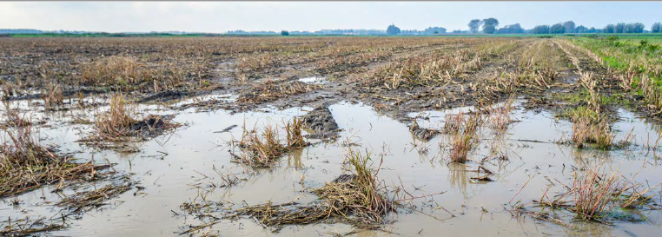
Activities which cause soil compaction
Harvesting crops during late autumn/winter (vegetables, maize, potatoes)
Late crop drilling in the autumn, particularly if the last machinery pass compresses the soil (e.g. discs, rollers, power harrow)
Winter slurry/manure spreading when stores are full
Outwintering of livestock
Winter farm traffic along headlands, tracks and buffer strips

Slide 10
Soil compaction
Compaction may not be immediately obvious as it can be subtle; less severe compaction occurs within fields and can be found at various levels in the soil profile
All compaction restricts downward water movement and can lead to surface saturation and surface run-off
Compaction may not radically affect crop yield so is unlikely to be a high priority for farmers, but has major consequences off-farm (flooding/water pollution)
For more details refer to Future Farming and Environment Evidence Compendium and Soils and Natural Flood Management under Further Information

Slide 11
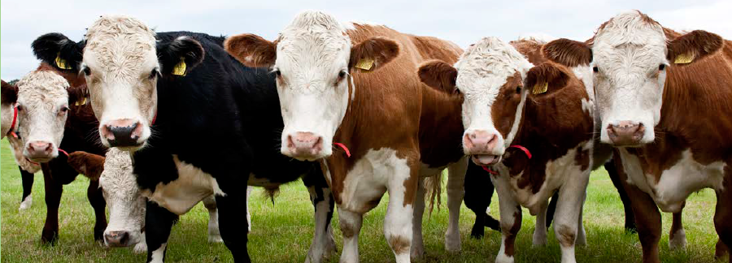
Sources of diffuse pollution
The Water Framework Directive’s (WFD) reasons for failure database was used to identify key sources of diffuse pollution
The most important identifiable on-farm sources were:
Arable fields (26%)
Mixed agricultural run-off (21-24%)
Dairy/beef fields (13%)

Slide 12
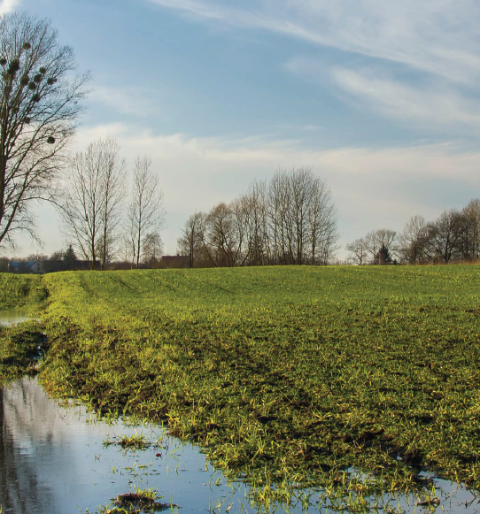
The Demonstration Test Catchment Project (DTC)
DTC is a multi-partner collaborative research programme comprising academics, farmers, industry experts, environmental organisations and policymakers which explores solutions to improving water quality in agricultural landscapes.
The effects of different mitigation measures have been monitored from 2010/11 - 2019 in four river systems:
Eden (Cumbria)
Avon (Hampshire, Wiltshire)
Wensum (Norfolk)
Tamar (Devon/Cornwall)
As these catchments represent major UK soil/rainfall combinations found on typical English and Welsh farms, the data collected from this work can be applied to other locations

Slide 13
Recent research from DTC
At the scale of water management catchments, agricultural water pollutant pressures from excess phosphorus, sediment, and nitrogen are localised.
There are 93 water management catchments in England; of these, 88 are adversely affected by phosphorus pollution, 77 by sediment, and 52 by nitrate and nearly half the catchments have pressures from all three pollutants.
The presence of multiple pollutants in many areas shows a need for targeted on-farm mitigation strategies. To achieve this, we recommend detailed site-specific on-farm assessments to target relevant individual measures to prevent pollutants cascading into water.

Slide 14
Methods
‘Basic’ measures are the minimum control practices required to reduce pollution within existing EU regulations and WFD guidelines. These measures are not having the desired effect, so over 700 ‘alternative basic’ measures which could reduce nutrient/sediment pollution from farms across England were reviewed.
‘Alternative basic’ measures are defined as: reflecting good farming practice, effective at reducing losses of specified pollutants commonly associated with water quality failing WFD standards

Slide 15
Methods
63 ‘alternative basic’ measures that scored highly in terms of acceptability, practicability, and applicability were shortlisted after working with actors from the agricultural industry
To refine this list further, a modelling tool containing DTC farm survey data was used to identify the 12 most effective mitigation measures at a national scale

Slide 16
The 12 most effective on-farm mitigation measures in descending order
New ‘alternative’ mitigation methods
1. Use a fertiliser recommended system
Current NVZ or cross compliance regulations
5. Do not apply manufactured fertiliser to high-risk areas
2. Do not apply manufactured fertiliser to high P index soils (Olsen soil P index of >4
3. Move feeders at regular intervals
4. Leave over-winter stubbles
6. Site solid manure heaps away from watercourses/field drains
7. No overgrazing of natural/semi-natural grassland
8. Do not spread slurry/poultry manure at high risk times
9. Do not apply manure to high risk areas
10. Increase capacity of farm slurry stores to improve timing of slurry application
11. Incorporate manure into soil
12. Avoid spreading manufactured fertiliser at high-risk times

Slide 17
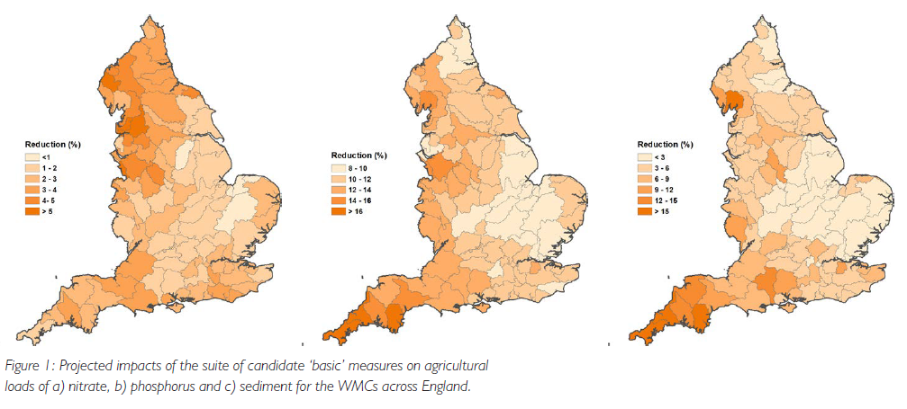
Results
The 12 shortlisted ‘alternative basic’ measures for livestock/arable farms would reduce national diffuse pollution loads of phosphorus by ~12%, sediment by ~6%, and nitrate by ~2%

Slide 18
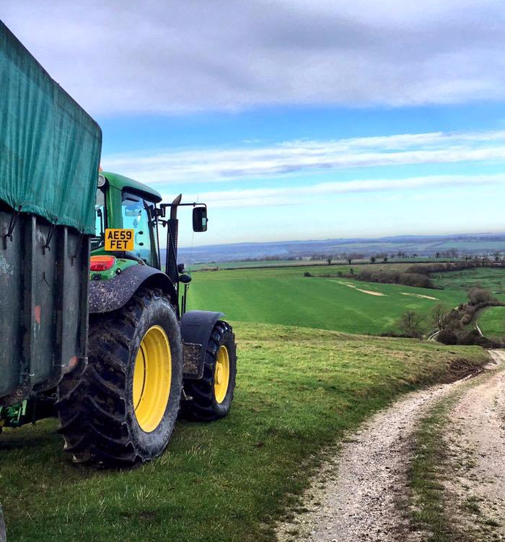
Results
The estimated cost of applying these 12 measures across England with an implementation rate of 95% would be £450m/yr (£52/ha)
These results fed into a broader consultation exercise which led to the introduction of the New Farming Rules for Water in England on 2/4/2019

Slide 19
Opportunities for policy and practice
Water policy focuses on gathering evidence for cost-effective mitigation measures
DTC can deliver this at a catchment scale, although it will take decades to confirm impacts from targeted on-farm mitigation measures using monitoring data
However, modelling techniques using research data from projects such as DTC can inform policy in the short-term about the technically feasible costs and effectiveness of pollution control measures

Slide 20
Advice surrounding mitigation measures for improving water quality
A major barrier to uptake of diffuse pollution mitigation methods in the farming community is the lack of a consistent clear message from a trusted messenger they meet regularly
Advice should be part of an iterative learning process; farmers typically prefer 1:1 advice delivered on-farm, and a single one-off transfer of knowledge is insufficient; continuity is essential for building trusting relationships

Slide 21
Advice surrounding mitigation measures for improving water quality
Depending on the catchment, different organisations were used more for advice, implying that knowing who to collaborate with and where is essential
During this period of limited public-sector budgets, it is worth exploring the full extent to which resources could be made available from actors within the supply chain, all of whom ultimately depend on sustainable land management for their continued existence

Slide 22
Improving advice surrounding mitigation measures for water quality
In the context of the UK’s decision to depart the EU, there remains widespread recognition that mandatory ‘basic’ measures should be retained as part of a mix of policies for protecting aquatic resources
Efforts should be made to:
1. Facilitate and support advisors to collaborate between themselves to provide efficient, clear, effective advice
2. Invest resources in a properly equipped extension service with necessary technical/social skills to engage effectively with the agricultural sector
3. Ensure farm advisor continuity and to enhance communication/coordination amongst the various actors

Slide 23
Further information
Collins, A.L., Newell Price, J.P., Zhang, Y., Gooday, R., Naden, P.S. & Skirvin, D. (2018) Assessing the potential impacts of a revised set of on-farm nutrient and sediment ‘basic’ control measures for reducing agricultural diffuse pollution across England. Science of The Total Environment, 621, 1499-1511.
Collins, A.L., Zhang, Y.S., Winter, M., Inman, A., Jones, J.I., Johnes, P.J., Cleasby, W., Vrain, E., Lovett, A. & Noble, L. (2016) Tackling agricultural diffuse pollution: What might uptake of farmer-preferred measures deliver for emissions to water and air? Science of the Total Environment, 547, 269-281.
DEFRA (2018) Future Farming and Environment Evidence Compendium. pp. 68.
DEFRA (2018) A green future: our 25 year plan to improve the environment.
Smith, R. (2017) Soils and natural flood management: Devon and Cornwall. CaBa (Catchment Based Approach): partnership for Action.
Zhang, Y., Collins, A.L., Johnes, P.J. & Jones, J.I. (2017a) Projected impacts of increased uptake of source control mitigation measures on agricultural diffuse pollution emissions to water and air. Land Use Policy, 62, 185-201
Zhang, Y., Collins, A.L., Johnes, P.J. & Jones, J.I. (2017a) Projected impacts of increased uptake of source control mitigation measures on agricultural diffuse pollution emissions to water and air. Land Use Policy, 62, 185-201.
Zhang, Y., Collins, A.L., Jones, J.I., Johnes, P.J., Inman, A. & Freer, J.E. (2017b) The potential benefits of on-farm mitigation scenarios for reducing multiple pollutant loadings in prioritised agri-environment areas across England. Environmental Science & Policy, 73, 100-114.
Images used supplied by Adie Collins, Charlotte Chivers, Shutterstock.

Slide 24
Acknowledgements
The participation of farmers in the DTC attitudinal survey and the input of ADAS farm advisors in quality assuring the farmer returns from the Avon DTC is gratefully acknowledged.
The research presented was funded by Defra via projects WQ02010, WQ2011, WQ02012 and LM0304. In addition, work on ‘basic measures’, was funded by Defra project WQ0223; Developing a field tool kit for ecological targeting of agricultural diffuse pollution mitigation measures, and Environment Agency project RM830; Identification of basic measures to address agriculture’s impact on water (to inform the joint Arm’s Length Body development and implementation of the Strategic Framework).

