Slide 1

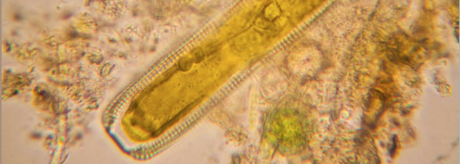
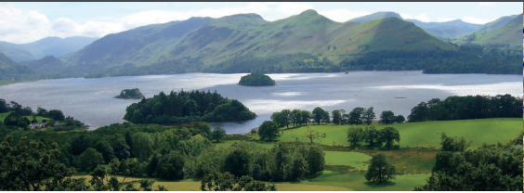
SCIENCE, POLICY AND PRACTICE NOTE 3
Assessing the impacts of pollutants on freshwater ecology
Emma Pilgrim & Michael Winter (University of Exeter)
Iwan Jones (Queen Mary University of London)
Adie Collins & Alison Carswell (Rothamsted Research)
Moragh Stirling (University of Reading)
Robin Hodgkinson & Carla Richmond (ADAS)

Slide 2
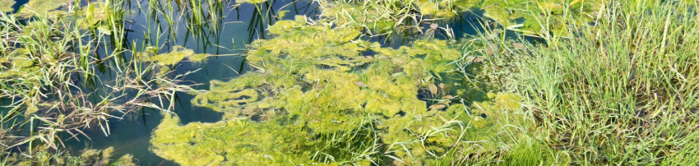
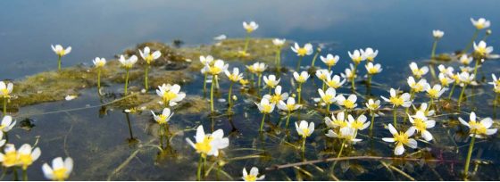
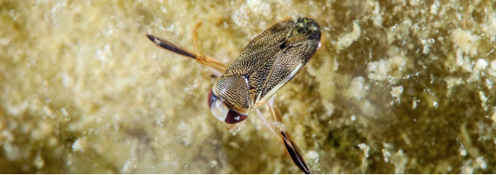
The issue
Freshwater pollution caused by organic matter, nutrients, sediment, and other contaminants can create multiple pressures on freshwater life
Freshwater life can respond in a similar way to several different pressures, making it difficult to separate out which of these individual or collective contaminants are responsible for any impacts

Slide 3
One pollutant can cause several problems
For example:
Slurry entering water courses acts as organic pollution by removing oxygen from water thus suffocating water life, whilst the particulate content of slurry can bind to sediment particles, increasing oxygen demand through becoming part of the sediment-associated organic matter. As the slurry breaks down, it also releases additional pollutants in the form of nutrients, leading to detrimental effects on freshwater organisms.

Slide 4

The issue
Interpreting changes to the ecology of rivers to identify the cause of problems is challenging as the effects of measures to mitigate one pollutant may be masked by the impact of other water impurities
More evidence is needed to incorporate a greater understanding of how different pollution stressors interact and subsequent impacts this has on freshwater life to enable a more accurate interpretation of how pollution from agriculture causes changes in freshwater wildlife

Slide 5
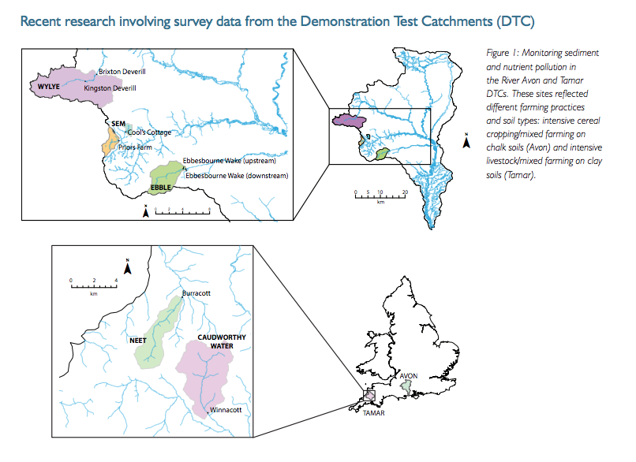
Recent research involving survey data from the Demonstration Test Catchments (DTC)

Slide 6

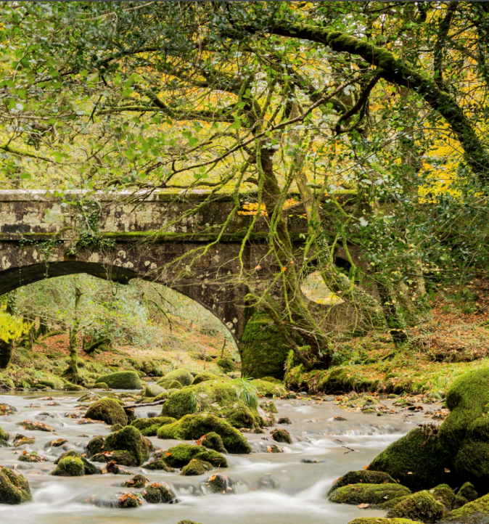
Why monitor freshwater ecology?
Between 2010-2019, a monitoring programme assessed how wildlife responds to changes in agricultural diffuse pollutants
By monitoring freshwater ecology, we can understand the health or condition of the environment and its ability to provide these benefits

Slide 7
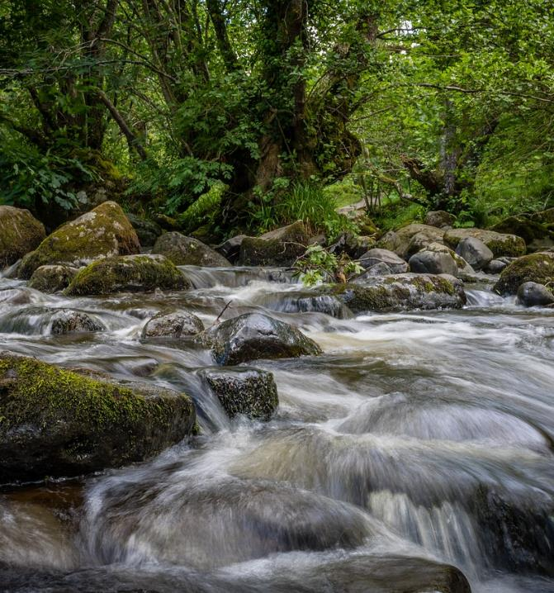
Why monitor freshwater ecology?
Regular assessment of freshwater ecology provides an integrated measure of the impact of pollutants over time
This is particularly useful if pollutants arrive in a pulse; with chemical measurements, pulses allow us to detect incidents
Wildlife responds to a wide range of pollutants, not just those we measure with standard techniques. If there is a problem, it will show up in the ecology. The challenge is to understand what is causing the problem

Slide 8
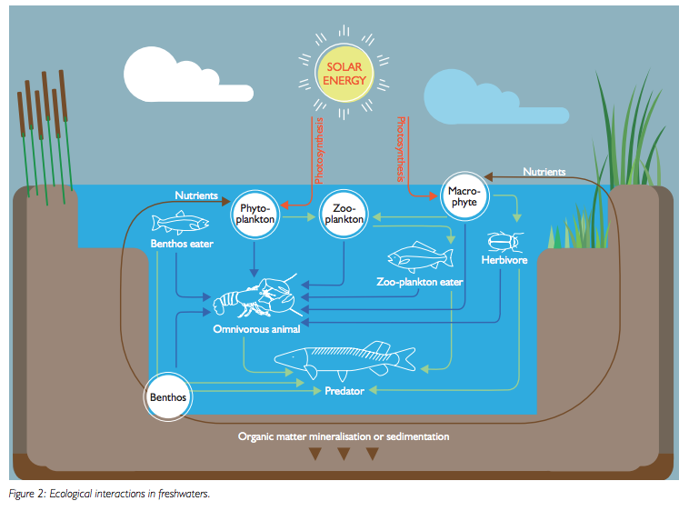

Slide 9
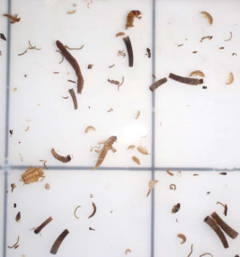
Monitoring freshwater life
Some tools for monitoring freshwater life are more reliable than others
Many tools are influenced by factors other than the pollutants they are supposed to measure; they therefore require additional observations to support their conclusions
A more holistic approach is required that incorporates a range of different parameters.

Slide 10

Recovery of freshwater life
Recovery in watercourses can be rapid, to an extent. Rate of recovery will then depend on landscape characteristics; e.g. freshwater invertebrates are most sensitive to low levels of oxygen in the water
Given the right conditions, invertebrates can recover from low oxygen in as little as two weeks
Level of recovery is complex as it depends on how quickly organisms can recolonise from elsewhere

Slide 11
Recovery of freshwater life
The extent of damage determines the speed at which the freshwater life can recover
If surrounding landscape has suffered significant environmental damage, recovery of biological life will be slower compared with a landscape that still retains some of its natural wildlife
Sites close to clean or less polluted water resources are described as ‘well connected’, particularly if there are routes for organisms to travel along

Slide 12
What we learnt
The mobility of the species is important; flying insects can move to new habitats more rapidly than species which are dependent on other transport mechanisms (wind, flowing water or animals)
The biological and chemical components of freshwater differ in the length of their recovery period. Because of the need for species to recolonise damaged sites, the chemical composition of the water frequently recovers more swiftly than the fauna and flora
Long-term biological and chemical monitoring is valuable for providing robust evidence that can underpin effective policy

Slide 13
Further Resources
Collins, AL, Haygarth P, Barker P, Hiscock K, Lovett A, Lloyd CEM, Freer JE, Johnes PJ & Jones JI (2015) Summary of emerging evidence from the Demonstration Test Catchments (DTC) Platform. Defra.

Slide 14
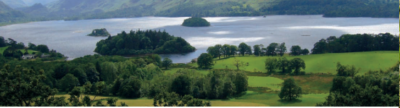
Acknowledgements
The Demonstration Test Catchment (DTC) project (Defra projects WQ02010, WQ2011, WQ02012 and LM0304) is a multi-partner collaborative research programme comprising academics, farmers, industry experts, environmental organisations and policymakers.
DTC explores solutions to improving water quality in agricultural landscapes. The effects of different mitigation measures have been monitored from 2010/11 - 2017 in four river systems: Eden (Cumbria), Avon (Hampshire, Wiltshire), Wensum (Norfolk) and Tamar (Devon/Cornwall). As these catchments represent major UK soil/rainfall combinations found on typical English and Welsh farms the data collected from this work can be applied to other locations. Waterlife vectors created by Freepik.
Photo credit: Pixabay, Agriland, Freshwater Habitats Trust

